Slide 1
Object Oriented Analysis and Design
Sequence Diagrams

Slide 2
Sequence Diagrams
A sequence diagram is representation of object interactions arranged in time sequence . It depicts the objects and classes involved in the scenario and the sequence of messages exchanged between the objects
Sequence diagrams are typically associated with use case

Slide 3
Sequence Diagram
Sequence diagram represents the dynamic interaction between objects, or between actors and objects ordered in time.
A sequence diagram is composed of a timeline, objects that interact across this timeline, and the messages that they exchange.
Represent a scenario in the system

Slide 4
Major Ingredients of a Sequence Diagram
1: enquiresAvailability
Message
Self Message
Focus of Control
Steps in the
Sequence
Notes
The Actor
Object
Time Line
: Patient
aPatient :Patient
Patient Checks
Availability of Doctor

Slide 5
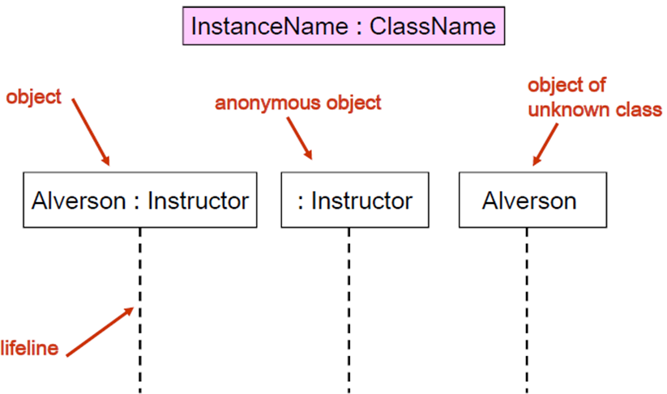
Representing objects

Slide 6
Message
Message (method call) indicated by horizontal arrow
Message include message description which is known as the message signature
attribute = message_name (arguments): return_type

Slide 7
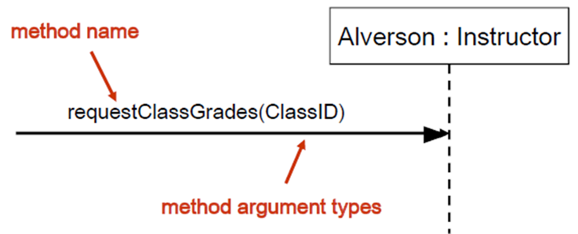
Message
Example:

Slide 8
Messages types
Synchronous message
A synchronous message is used when the sender waits for the receiver to process the message and return before carrying on with another message.
Use solid arrowhead

Slide 9
Messages types
Asynchronous message
A synchronous message is used when the message caller does not wait for the receiver to process the message and return before sending other messages to other objects.
Use line arrowhead

Slide 10
Messages types
Return message
A return message is used to indicate that the message receiver is done processing the message and is returning control over to the message caller.
Use dashed line arrowhead

Slide 11
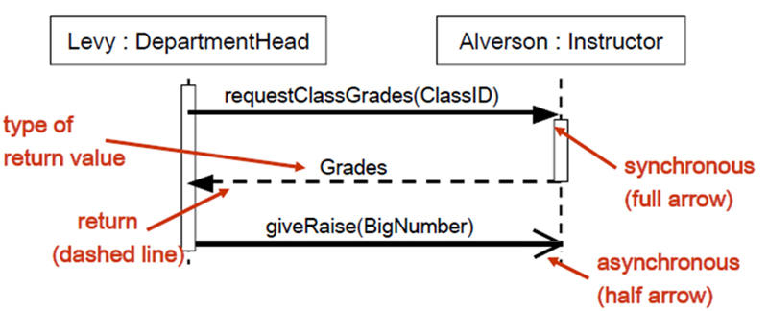
Messages types
Example:

Slide 12
Activation Bar
Activation bar or focus of control is the box placed on the lifeline. It is used to indicate that an object is active (or instantiated) during an interaction between two objects. The length of the rectangle indicates the duration of the objects staying active.
Drawn when object method is on method stack waiting for other objects to finish,

Slide 13
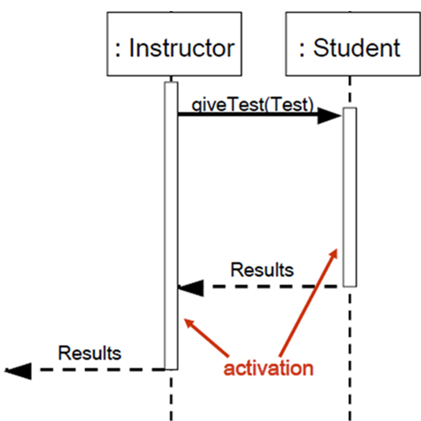
Indicating method calls
Example:

Slide 14
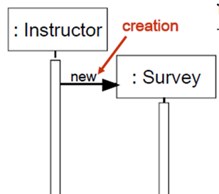
Creation message
Indicate the object is created according to the message that is being sent.
Arrow with new word to object

Slide 15
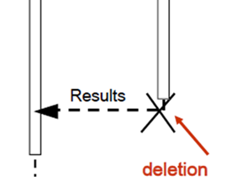
Destruction/Deletion
when an object is no longer needed it can also be deleted from a sequence diagram.

Slide 16
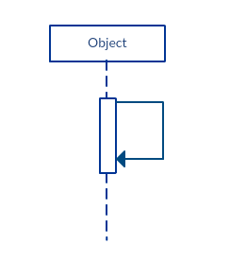
Reflexive message
When an object sends a message to itself,

Slide 17
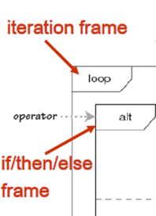
Conditions and loops
Fragment/Frame
Section of interactions between objects
It is used to show complex interactions such as alternative flows and loops in a more structured way
Fragment operator
Left top corner
Specifies what sort of a fragment it is

Slide 18
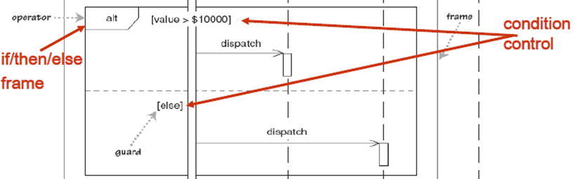
Alternative Fragments
Used when a choice needs to be made between two or more message sequences.
It models the “if then else” logic.

Slide 19
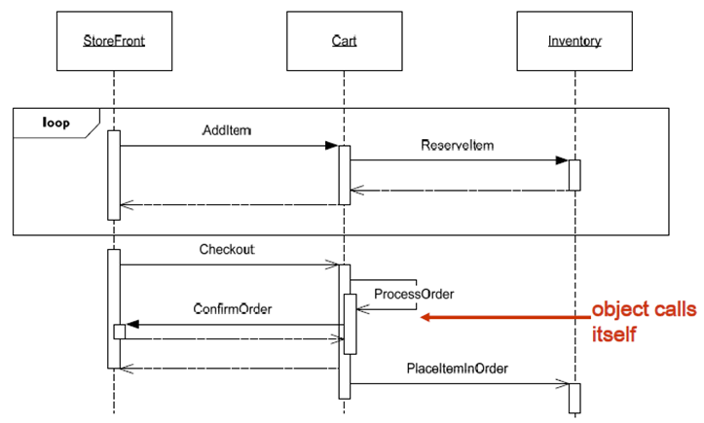
Loops
Used to represent a repetitive sequence

Slide 20
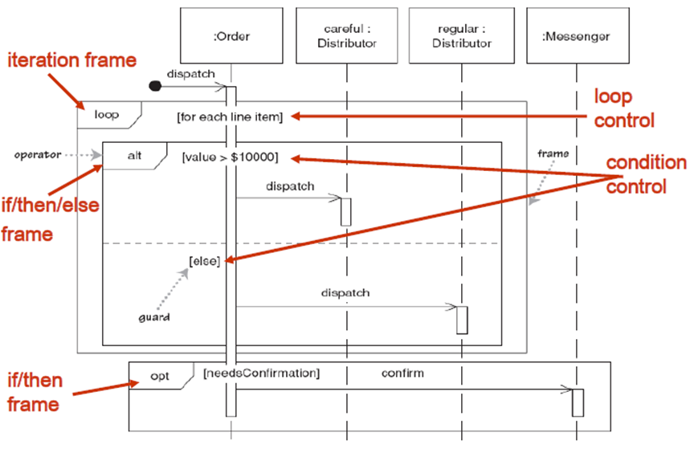
Example:

Slide 21
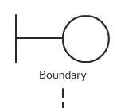
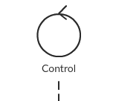
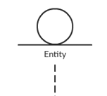
Stereotypes
Object specifying mechanism in the Unified Modeling Language (UML)

Slide 22
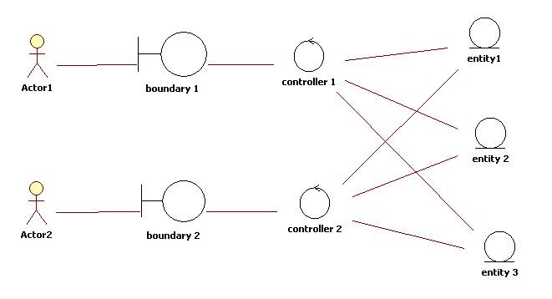
The Entity-Control-Boundary Pattern

Slide 23
